Slide 1
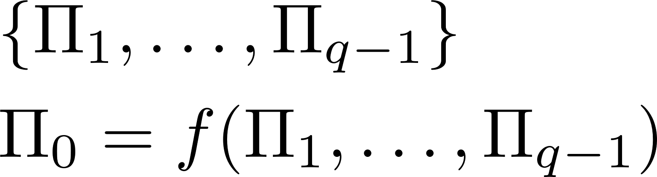
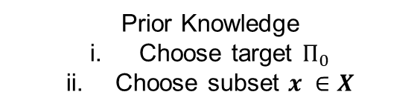
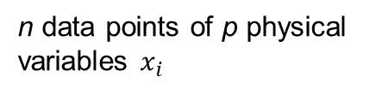

Data Collection & Preprocessing
Processed Data $X$
Prior Knowledge
Choose target $Π_{0}$
Choose subset $x ∈X$
n data points of p physical variables $x_{i}$
Discovery Method
Optimization

Slide 2
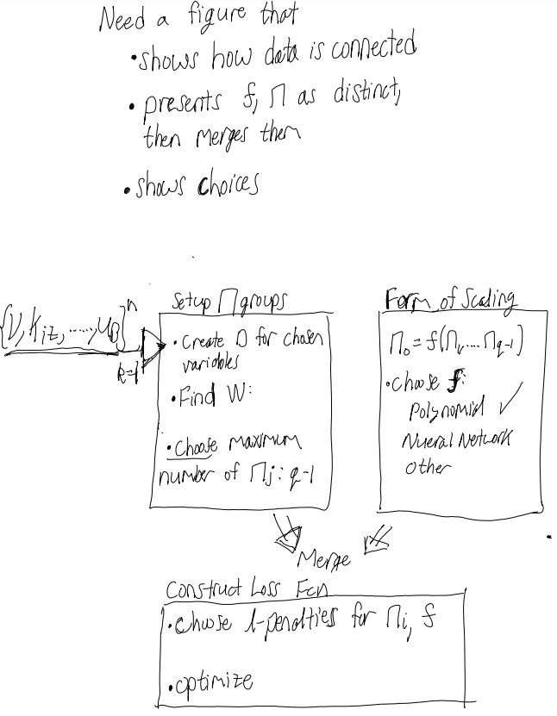

Slide 3
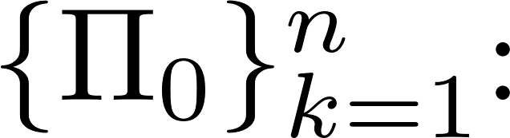
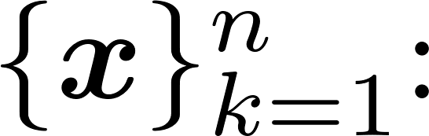

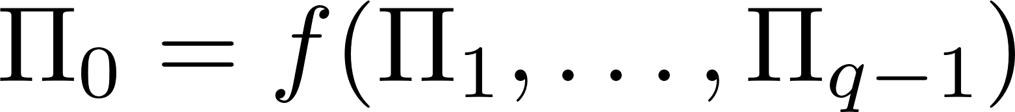
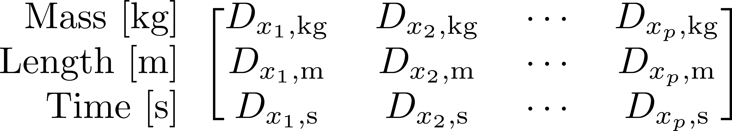
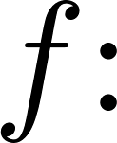



Inputs
Target Dimensionless Number
Input variables
Set Up Dimensionless Numbers
Define Structure of Scaling Relation
Select
Left out:
DW = 0
W is used to
construct
Dimensionless
numbers
Polynomial Regression?
Neural Network?
Other?
Find null space of
Select q:
how many dimensionless numbers?
Optimize
Choose hyperparameters for loss function
Left out:
Hyperparameters on f
Polynomial reg: order
NN: depth and width
Left out:
Other optimization hyperparamters

Slide 4


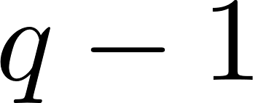
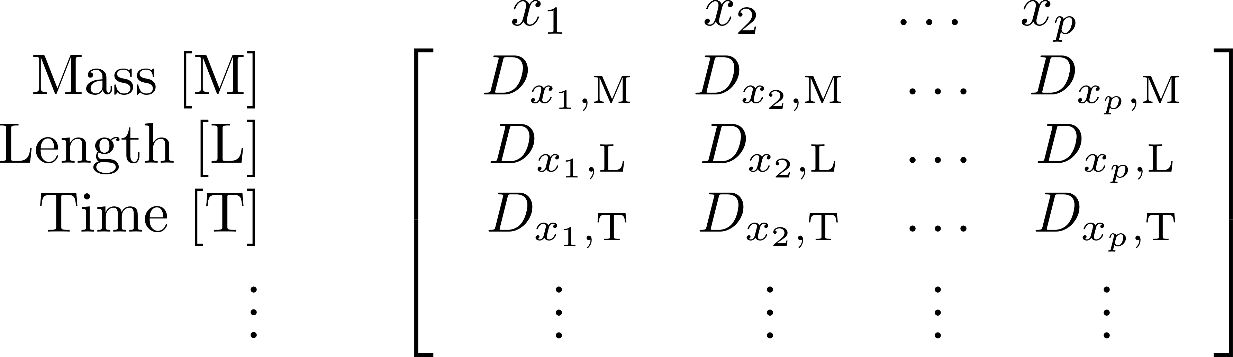



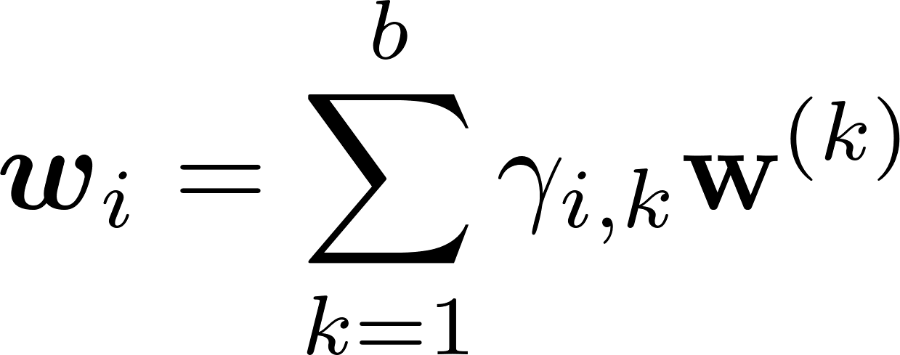



User Inputs
User Inputs
Process Variables of the System
Target Dimensionless Number
Quantity of Dimensionless Numbers to Discover
a. Construct dimension matrix,
Let scaling relation take the form of
Define Structure of Scaling Relation
d. Select structure of scaling relation, , e.g.,
Polynomial
Neural network
where is parameterized by structural parameters
Set up Dimensionless Numbers
b. Find null space of
Let a solution to be
e. Optimize a loss function,
Outputs
(Newly) Identified Dimensionless Numbers
Scaling Relation
Notes:
\begin{array}{rc}
\begin{array}{r}
\\
\text{Mass }[\text{M}] \\
\text{Length }[\text{L}] \\
\text{Time }[\text{T}] \\
\vdots
\end{array} &
\begin{array}{c}
\begin{array}{cccc}
x_{1}~\quad & x_{2}~\quad & \ldots & x_{p}~\quad \\
\end{array} \\
\left[%
\begin{array}{cccc}
d_{x_1,\text{M}} & d_{x_2,\text{M}} & \ldots & d_{x_p,\text{M}}\\
d_{x_1,\text{L}} & d_{x_2,\text{L}} & \ldots & d_{x_p,\text{L}}\\
d_{x_1,\text{T}} & d_{x_2,\text{T}} & \ldots & d_{x_p,\text{T}}\\
\vdots & \vdots & \vdots & \vdots\\
\end{array}%
\right]
\end{array}
\end{array}
\mathbf{DW} = 0, \quad \text{Col}(\mathbf{W}) = \mathbf{w}^{(1)},\ldots,\mathbf{w}^{(b)}
\Pi_0 = f(\Pi_1, \ldots, \Pi_{q-1}),\quad \Pi_i = \prod_{j=1}^{p}x_j^{w_j}
\mathbf{w} = \sum_{i=1}^{b}\gamma_i\mathbf{w}^{(i)} = [w_1, \ldots, w_p]
\boldsymbol{\gamma}^*,\boldsymbol{\beta}^* = \argmin_{\boldsymbol{\gamma}, \boldsymbol{\beta}} ~ J(\boldsymbol{\gamma}, \boldsymbol{\beta})

Slide 5
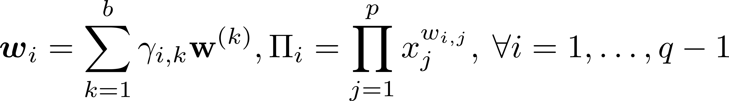
User Inputs
User Inputs
Process Variables
Target Dimensionless Number
Quantity of Dimensionless Numbers to Discover
a. Construct dimension matrix,
Let scaling relation take the form of
Learning a Sparse Model for the Target Dimensionless Number
d. Select structure of scaling relation, , e.g.,
Polynomial
Neural network
where is parameterized by structural parameters
Learning Input Dimensionless Numbers
b. Find null space of
c. Let a solution to be
e. Optimize a loss function,
Outputs
(Newly) Identified Dimensionless Numbers
Scaling Relation
Notes:
\begin{array}{rc}
\begin{array}{r}
\\
\text{Mass }[\text{M}] \\
\text{Length }[\text{L}] \\
\text{Time }[\text{T}] \\
\vdots
\end{array} &
\begin{array}{c}
\begin{array}{cccc}
x_{1}~\quad & x_{2}~\quad & \ldots & x_{p}~\quad \\
\end{array} \\
\left[%
\begin{array}{cccc}
d_{x_1,\text{M}} & d_{x_2,\text{M}} & \ldots & d_{x_p,\text{M}}\\
d_{x_1,\text{L}} & d_{x_2,\text{L}} & \ldots & d_{x_p,\text{L}}\\
d_{x_1,\text{T}} & d_{x_2,\text{T}} & \ldots & d_{x_p,\text{T}}\\
\vdots & \vdots & \vdots & \vdots\\
\end{array}%
\right]
\end{array}
\end{array}
\mathbf{DW} = 0, \quad \text{Col}(\mathbf{W}) = \mathbf{w}^{(1)},\ldots,\mathbf{w}^{(b)}
\Pi_0 = f(\Pi_1, \ldots, \Pi_{q-1}),\quad \Pi_i = \prod_{j=1}^{p}x_j^{w_j}
\mathbf{w} = \sum_{i=1}^{b}\gamma_i\mathbf{w}^{(i)} = [w_1, \ldots, w_p]
\boldsymbol{\gamma}^*,\boldsymbol{\beta}^* = \argmin_{\boldsymbol{\gamma}, \boldsymbol{\beta}} ~ J(\boldsymbol{\gamma}, \boldsymbol{\beta})

Slide 6
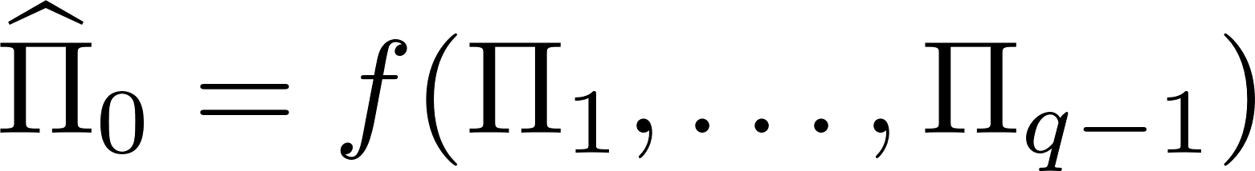
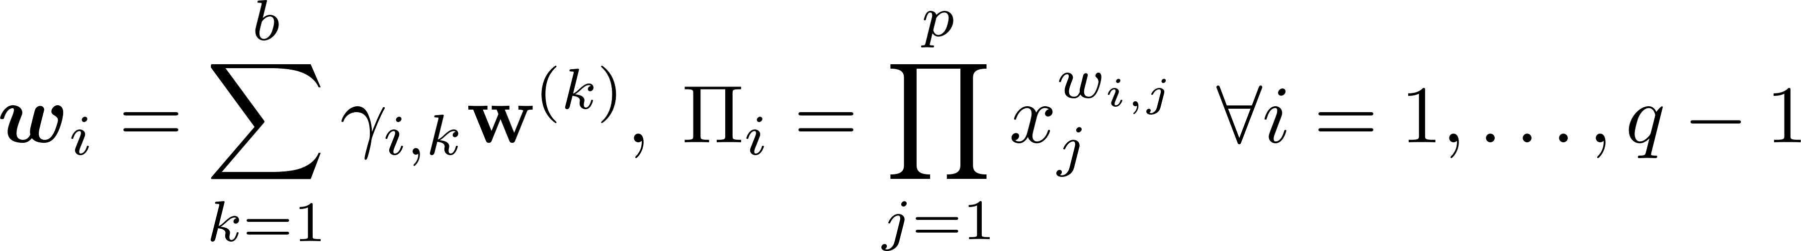
User Inputs
Quantity of
Dimensionless Numbers
to Discover
Process Variables
Target Dimensionless Number
a. Construct dimension matrix,
Let dimensionless relation take the form of
Learning a Sparse Model for the Target Dimensionless Number
d. Select structure of scaling relation, , e.g.,
Polynomial
Neural network
where is parameterized by structural parameters
Learning Input Dimensionless Numbers
b. Find null space of
c. Let a solution to be
e. Optimize a loss function,
Outputs
(Newly) Identified Dimensionless Numbers
Dimensionless Relation
Notes:
\begin{array}{rc}
\begin{array}{r}
\\
\text{Mass }[\text{M}] \\
\text{Length }[\text{L}] \\
\text{Time }[\text{T}] \\
\vdots
\end{array} &
\begin{array}{c}
\begin{array}{cccc}
x_{1}~\quad & x_{2}~\quad & \ldots & x_{p}~\quad \\
\end{array} \\
\left[%
\begin{array}{cccc}
d_{x_1,\text{M}} & d_{x_2,\text{M}} & \ldots & d_{x_p,\text{M}}\\
d_{x_1,\text{L}} & d_{x_2,\text{L}} & \ldots & d_{x_p,\text{L}}\\
d_{x_1,\text{T}} & d_{x_2,\text{T}} & \ldots & d_{x_p,\text{T}}\\
\vdots & \vdots & \vdots & \vdots\\
\end{array}%
\right]
\end{array}
\end{array}
\mathbf{DW} = 0, \quad \text{Col}(\mathbf{W}) = \mathbf{w}^{(1)},\ldots,\mathbf{w}^{(b)}
\Pi_0 = f(\Pi_1, \ldots, \Pi_{q-1}),\quad \Pi_i = \prod_{j=1}^{p}x_j^{w_j}
\mathbf{w} = \sum_{i=1}^{b}\gamma_i\mathbf{w}^{(i)} = [w_1, \ldots, w_p]
\boldsymbol{\gamma}^*,\boldsymbol{\beta}^* = \argmin_{\boldsymbol{\gamma}, \boldsymbol{\beta}} ~ J(\boldsymbol{\gamma}, \boldsymbol{\beta})

Slide 7
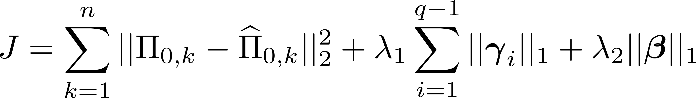

Step 1: User Inputs
Quantity of
Dimensionless Numbers
to Discover
Process Variables
Target Dimensionless Number
a. Construct dimension matrix,
Let dimensionless relation take the form of
Step 3: Learning a Sparse Model for the Target Dimensionless Number
d. Select structure of scaling relation, , e.g.,
Polynomial
Neural network
Step 2: Learning Input Dimensionless Numbers
b. Find null space of
e. Optimize a loss function,
c. Let a solution to be
Outputs
(Newly) Identified Dimensionless Numbers
Dimensionless Relation
Notes:
\begin{array}{rc}
\begin{array}{r}
\\
\text{Mass }[\text{M}] \\
\text{Length }[\text{L}] \\
\text{Time }[\text{T}] \\
\vdots
\end{array} &
\begin{array}{c}
\begin{array}{cccc}
x_{1}~\quad & x_{2}~\quad & \ldots & x_{p}~\quad \\
\end{array} \\
\left[%
\begin{array}{cccc}
d_{x_1,\text{M}} & d_{x_2,\text{M}} & \ldots & d_{x_p,\text{M}}\\
d_{x_1,\text{L}} & d_{x_2,\text{L}} & \ldots & d_{x_p,\text{L}}\\
d_{x_1,\text{T}} & d_{x_2,\text{T}} & \ldots & d_{x_p,\text{T}}\\
\vdots & \vdots & \vdots & \vdots\\
\end{array}%
\right]
\end{array}
\end{array}
\mathbf{DW} = 0, \quad \text{Col}(\mathbf{W}) = \mathbf{w}^{(1)},\ldots,\mathbf{w}^{(b)}
\Pi_0 = f(\Pi_1, \ldots, \Pi_{q-1}),\quad \Pi_i = \prod_{j=1}^{p}x_j^{w_j}
\mathbf{w} = \sum_{i=1}^{b}\gamma_i\mathbf{w}^{(i)} = [w_1, \ldots, w_p]
\boldsymbol{\gamma}^*,\boldsymbol{\beta}^* = \argmin_{\boldsymbol{\gamma}, \boldsymbol{\beta}} ~ J(\boldsymbol{\gamma}, \boldsymbol{\beta})

Slide 8
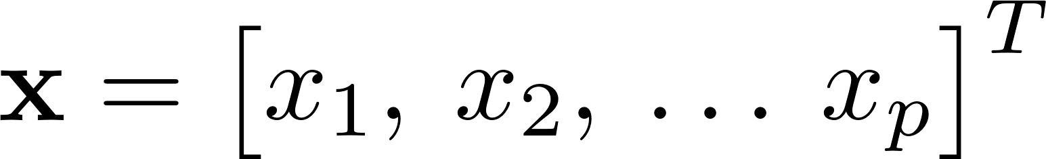

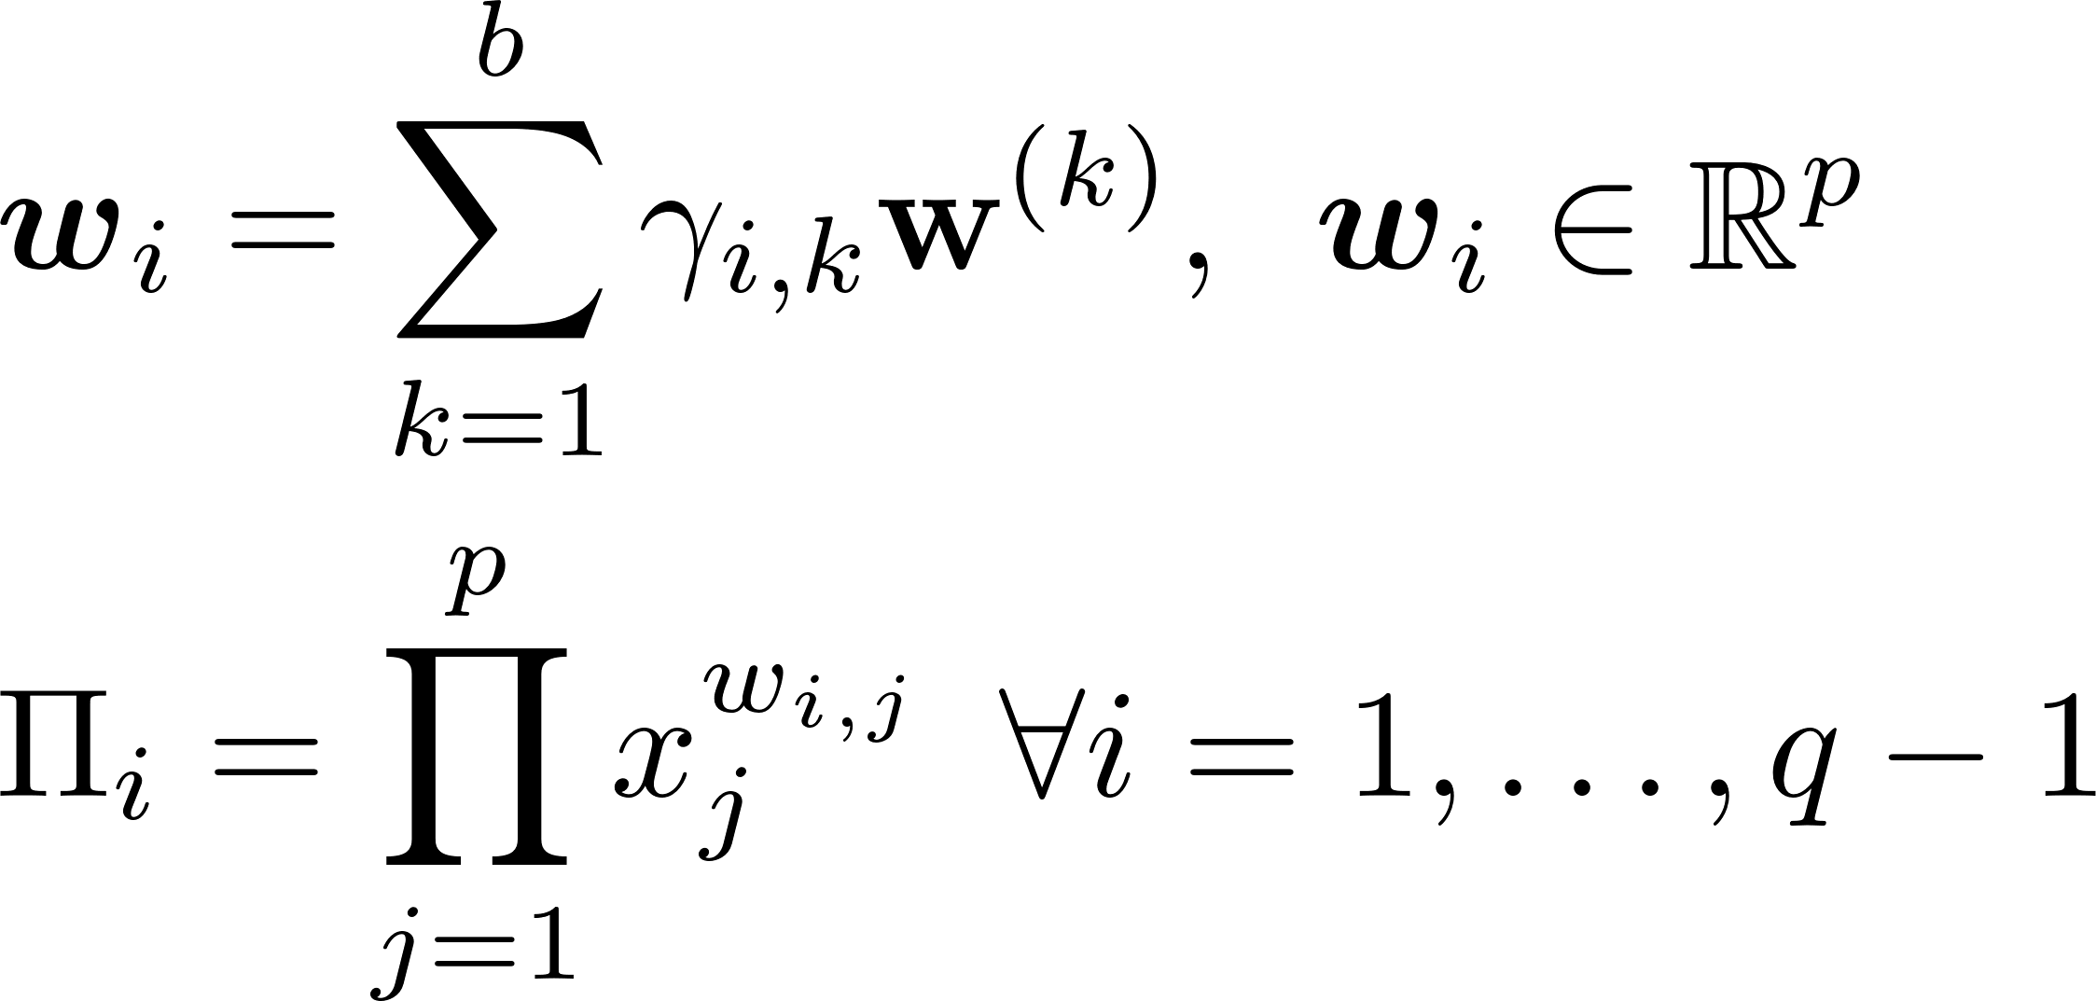
Step 1: Provide User Inputs
Quantity of
Dimensionless Numbers
to Discover
Process Variables
Target Dimensionless Number
a. Construct dimension matrix,
Let dimensionless relation take the form of
Step 3: Learning a Sparse Model for the Target Dimensionless Number
d. Select structure of scaling relation, , e.g.,
Polynomial
Neural network
Step 2: Learning Input Dimensionless Numbers
b. Find basis vectors of null space of
e. Optimize a loss function,
c. Discover Input Dimensionless Numbers
Outputs
(Newly) Identified Dimensionless Numbers
Dimensionless Relation
Notes:
\begin{array}{rc}
\begin{array}{r}
\\
\text{Mass }[\text{M}] \\
\text{Length }[\text{L}] \\
\text{Time }[\text{T}] \\
\vdots
\end{array} &
\begin{array}{c}
\begin{array}{cccc}
x_{1}~\quad & x_{2}~\quad & \ldots & x_{p}~\quad \\
\end{array} \\
\left[%
\begin{array}{cccc}
d_{x_1,\text{M}} & d_{x_2,\text{M}} & \ldots & d_{x_p,\text{M}}\\
d_{x_1,\text{L}} & d_{x_2,\text{L}} & \ldots & d_{x_p,\text{L}}\\
d_{x_1,\text{T}} & d_{x_2,\text{T}} & \ldots & d_{x_p,\text{T}}\\
\vdots & \vdots & \vdots & \vdots\\
\end{array}%
\right]
\end{array}
\end{array}
\mathbf{DW} = 0, \quad \text{Col}(\mathbf{W}) = \mathbf{w}^{(1)},\ldots,\mathbf{w}^{(b)}
\Pi_0 = f(\Pi_1, \ldots, \Pi_{q-1}),\quad \Pi_i = \prod_{j=1}^{p}x_j^{w_j}
\mathbf{w} = \sum_{i=1}^{b}\gamma_i\mathbf{w}^{(i)} = [w_1, \ldots, w_p]
\boldsymbol{\gamma}^*,\boldsymbol{\beta}^* = \argmin_{\boldsymbol{\gamma}, \boldsymbol{\beta}} ~ J(\boldsymbol{\gamma}, \boldsymbol{\beta})

Slide 9



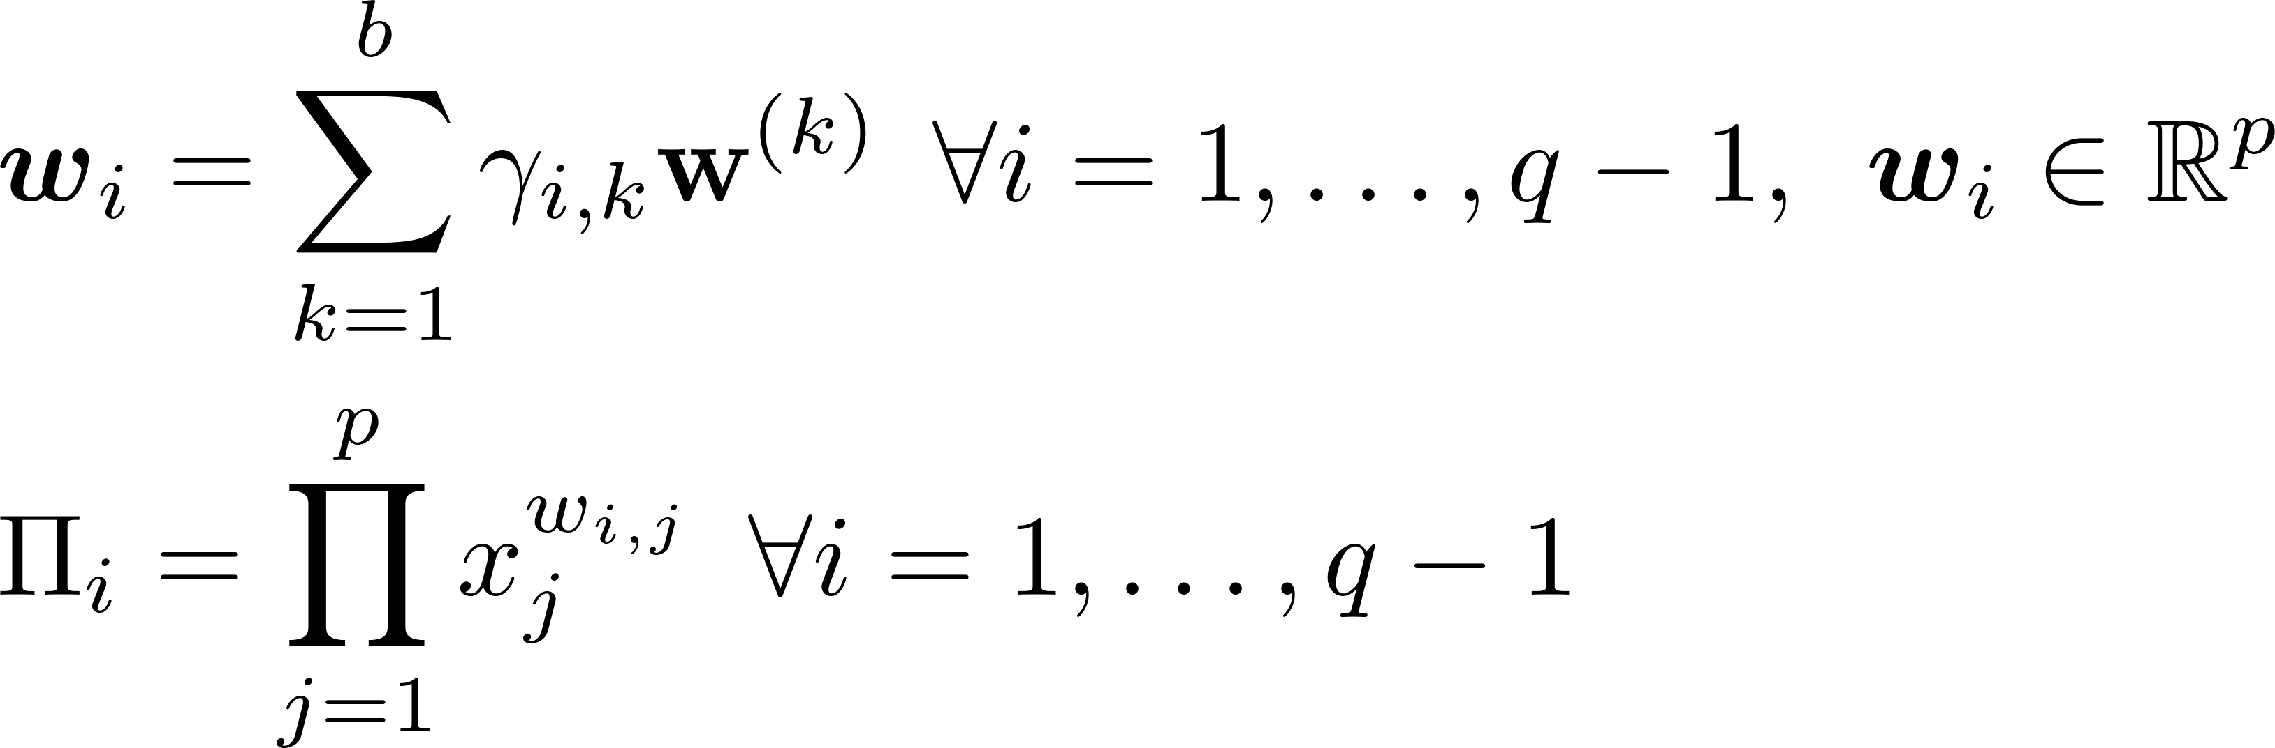
Step I: Provide User Inputs
Quantity of
Dimensionless Numbers
to Discover
Process Variables
Target Dimensionless Number
a. Construct dimension matrix,
Let dimensionless relation with parameters take the form of:
Step III: Learning a Sparse Model for the Target Dimensionless Number
d. Minimize the loss function:
to find coefficients and
Step II: Learning Input Dimensionless Numbers
b. Find basis vectors of null space of
c. Discover Input Dimensionless Numbers
Outputs
Input
Dimensionless Numbers
Sparse Model for Predicting the Target Dimensionless Number
Notes:
\begin{array}{rc}
\begin{array}{r}
\\
\text{Mass }[\text{M}] \\
\text{Length }[\text{L}] \\
\text{Time }[\text{T}] \\
\vdots
\end{array} &
\begin{array}{c}
\begin{array}{cccc}
x_{1}~\quad & x_{2}~\quad & \ldots & x_{p}~\quad \\
\end{array} \\
\left[%
\begin{array}{cccc}
d_{x_1,\text{M}} & d_{x_2,\text{M}} & \ldots & d_{x_p,\text{M}}\\
d_{x_1,\text{L}} & d_{x_2,\text{L}} & \ldots & d_{x_p,\text{L}}\\
d_{x_1,\text{T}} & d_{x_2,\text{T}} & \ldots & d_{x_p,\text{T}}\\
\vdots & \vdots & \vdots & \vdots\\
\end{array}%
\right]
\end{array}
\end{array}
\mathbf{DW} = 0, \quad \text{Col}(\mathbf{W}) = \mathbf{w}^{(1)},\ldots,\mathbf{w}^{(b)}
\Pi_0 = f(\Pi_1, \ldots, \Pi_{q-1}),\quad \Pi_i = \prod_{j=1}^{p}x_j^{w_j}
\mathbf{w} = \sum_{i=1}^{b}\gamma_i\mathbf{w}^{(i)} = [w_1, \ldots, w_p]
\boldsymbol{\gamma}^*,\boldsymbol{\beta}^* = \argmin_{\boldsymbol{\gamma}, \boldsymbol{\beta}} ~ J(\boldsymbol{\gamma}, \boldsymbol{\beta})

Slide 10
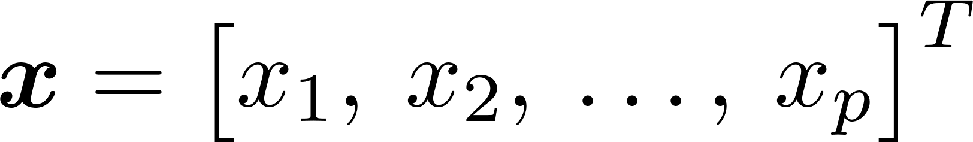
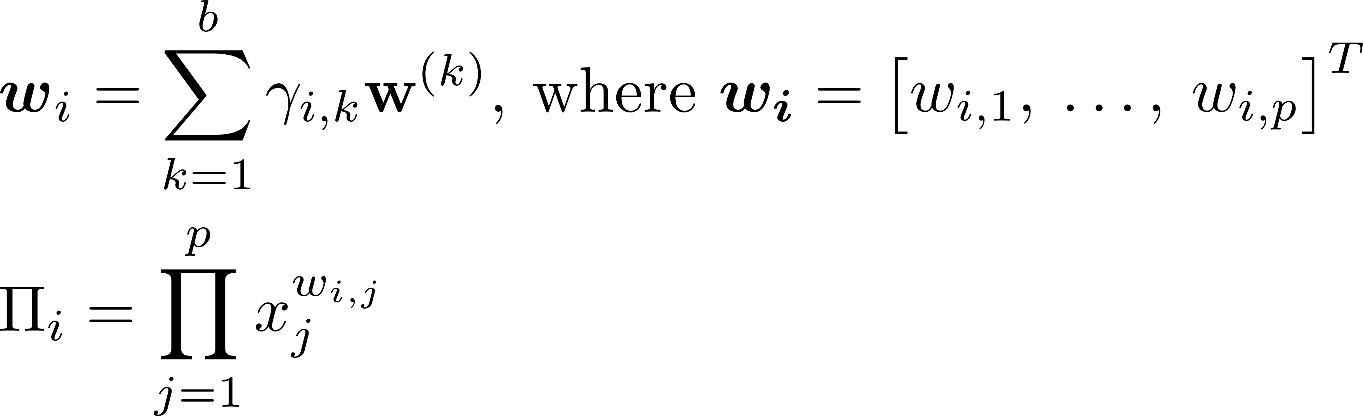
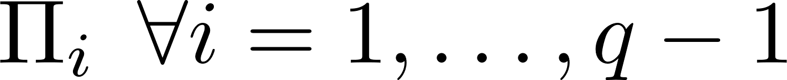
Step I: Provide User Inputs
Process Variables
Target Dimensionless Number
Quantity of Input
Dimensionless Numbers
a. Construct dimension matrix, :
Let dimensionless relation with parameters take the form of:
Step III: Learn a Sparse Model for the Target Dimensionless Number
d. Minimize the loss function:
to find coefficients and .
Step II: Learn Input Dimensionless Numbers
b. Find basis vectors of null space of :
c. Discover input dimensionless numbers:
Outputs
Input
Dimensionless Numbers
Sparse Model for Predicting the Target Dimensionless Number
Notes:
\begin{array}{rc}
\begin{array}{r}
\\
\text{Mass }[\text{M}] \\
\text{Length }[\text{L}] \\
\text{Time }[\text{T}] \\
\vdots
\end{array} &
\begin{array}{c}
\begin{array}{cccc}
x_{1}~\quad & x_{2}~\quad & \ldots & x_{p}~\quad \\
\end{array} \\
\left[%
\begin{array}{cccc}
d_{x_1,\text{M}} & d_{x_2,\text{M}} & \ldots & d_{x_p,\text{M}}\\
d_{x_1,\text{L}} & d_{x_2,\text{L}} & \ldots & d_{x_p,\text{L}}\\
d_{x_1,\text{T}} & d_{x_2,\text{T}} & \ldots & d_{x_p,\text{T}}\\
\vdots & \vdots & \vdots & \vdots\\
\end{array}%
\right]
\end{array}
\end{array}
\mathbf{DW} = 0, \quad \text{Col}(\mathbf{W}) = \mathbf{w}^{(1)},\ldots,\mathbf{w}^{(b)}
\Pi_0 = f(\Pi_1, \ldots, \Pi_{q-1}),\quad \Pi_i = \prod_{j=1}^{p}x_j^{w_j}
\mathbf{w} = \sum_{i=1}^{b}\gamma_i\mathbf{w}^{(i)} = [w_1, \ldots, w_p]
\boldsymbol{\gamma}^*,\boldsymbol{\beta}^* = \argmin_{\boldsymbol{\gamma}, \boldsymbol{\beta}} ~ J(\boldsymbol{\gamma}, \boldsymbol{\beta})

Slide 11

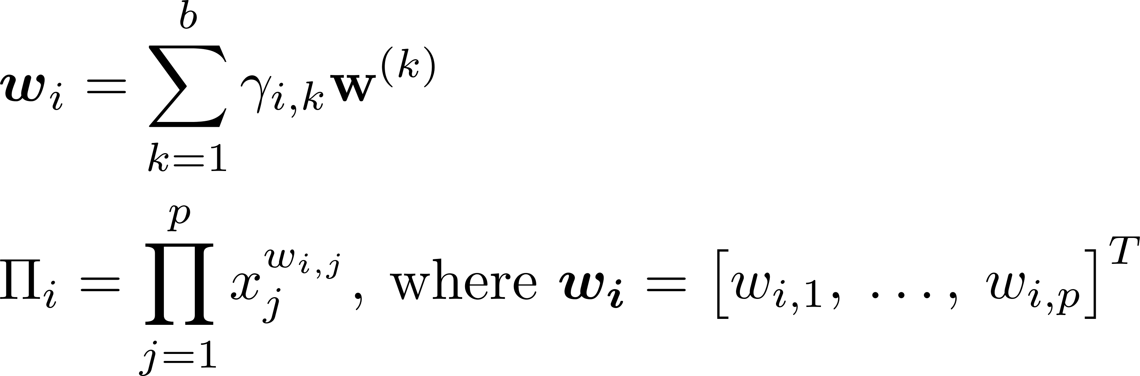
Step I: Provide User Inputs
Process Variables
Target Dimensionless Number
Quantity of Input
Dimensionless Numbers
a. Construct dimension matrix, :
Let dimensionless relation with parameters take the form of:
Step III: Learn a Sparse Model for the Target Dimensionless Number
d. Minimize the loss function:
to find coefficients and .
Step II: Learn Input Dimensionless Numbers
b. Find basis vectors of null space of :
c. Discover input dimensionless numbers:
Outputs
Input
Dimensionless Numbers
Sparse Model for Predicting the Target Dimensionless Number
Notes:
\begin{array}{rc}
\begin{array}{r}
\\
\text{Mass }[\text{M}] \\
\text{Length }[\text{L}] \\
\text{Time }[\text{T}] \\
\vdots
\end{array} &
\begin{array}{c}
\begin{array}{cccc}
x_{1}~\quad & x_{2}~\quad & \ldots & x_{p}~\quad \\
\end{array} \\
\left[%
\begin{array}{cccc}
d_{x_1,\text{M}} & d_{x_2,\text{M}} & \ldots & d_{x_p,\text{M}}\\
d_{x_1,\text{L}} & d_{x_2,\text{L}} & \ldots & d_{x_p,\text{L}}\\
d_{x_1,\text{T}} & d_{x_2,\text{T}} & \ldots & d_{x_p,\text{T}}\\
\vdots & \vdots & \vdots & \vdots\\
\end{array}%
\right]
\end{array}
\end{array}
\mathbf{DW} = 0, \quad \text{Col}(\mathbf{W}) = \mathbf{w}^{(1)},\ldots,\mathbf{w}^{(b)}
\Pi_0 = f(\Pi_1, \ldots, \Pi_{q-1}),\quad \Pi_i = \prod_{j=1}^{p}x_j^{w_j}
\mathbf{w} = \sum_{i=1}^{b}\gamma_i\mathbf{w}^{(i)} = [w_1, \ldots, w_p]
\boldsymbol{\gamma}^*,\boldsymbol{\beta}^* = \argmin_{\boldsymbol{\gamma}, \boldsymbol{\beta}} ~ J(\boldsymbol{\gamma}, \boldsymbol{\beta})

Slide 12

User Inputs
Physical Variables of the System
Target Dimensionless Number
a. Construct dimension matrix,
Let scaling relation take the form of
Define Structure of Scaling Relation
d. Select structure of scaling relation, , e.g.,
Polynomial
Neural network
where is parameterized by structural parameters
Set up Dimensionless Numbers
b. Find null space of
Let a solution to be
e. Optimize a loss function,
Outputs
(Newly) Identified Dimensionless Numbers
Scaling Relation
Notes:
\begin{array}{rc}
\begin{array}{r}
\\
\text{Mass }[\text{M}] \\
\text{Length }[\text{L}] \\
\text{Time }[\text{T}] \\
\vdots
\end{array} &
\begin{array}{c}
\begin{array}{cccc}
x_{1}~\quad & x_{2}~\quad & \ldots & x_{p}~\quad \\
\end{array} \\
\left[%
\begin{array}{cccc}
d_{x_1,\text{M}} & d_{x_2,\text{M}} & \ldots & d_{x_p,\text{M}}\\
d_{x_1,\text{L}} & d_{x_2,\text{L}} & \ldots & d_{x_p,\text{L}}\\
d_{x_1,\text{T}} & d_{x_2,\text{T}} & \ldots & d_{x_p,\text{T}}\\
\vdots & \vdots & \vdots & \vdots\\
\end{array}%
\right]
\end{array}
\end{array}
\mathbf{DW} = 0, \quad \text{Col}(\mathbf{W}) = \mathbf{w}^{(1)},\ldots,\mathbf{w}^{(b)}
\Pi_0 = f(\Pi_1, \ldots, \Pi_{q-1}),\quad \Pi_i = \prod_{j=1}^{p}x_j^{w_j}
\mathbf{w} = \sum_{i=1}^{b}\gamma_i\mathbf{w}^{(i)} = [w_1, \ldots, w_p]
\boldsymbol{\gamma}^*,\boldsymbol{\beta}^* = \argmin_{\boldsymbol{\gamma}, \boldsymbol{\beta}} ~ J(\boldsymbol{\gamma}, \boldsymbol{\beta})

Slide 13



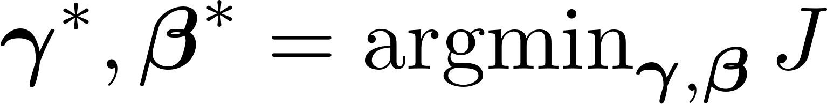
Inputs
Target Dimensionless Number
Input variables
Set Up Dimensionless Numbers
Define Structure of Scaling Relation
Left out:
DW = 0
W is used to
construct
Dimensionless
numbers
Select
Polynomial Regression?
Neural Network?
Other?
Find null space of
Left out:
Hyperparameters on f
Polynomial reg: order
NN: depth and width
Select q:
how many dimensionless numbers?
Optimize
Choose penalty for sparse dimensionless numbers
Left out:
Other optimization hyperparamters

Slide 14

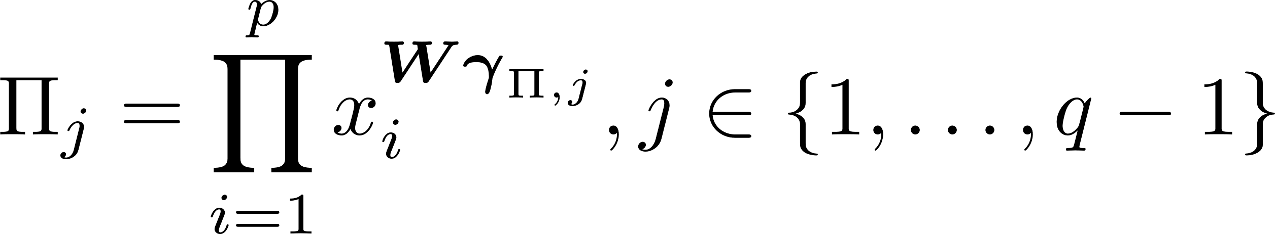

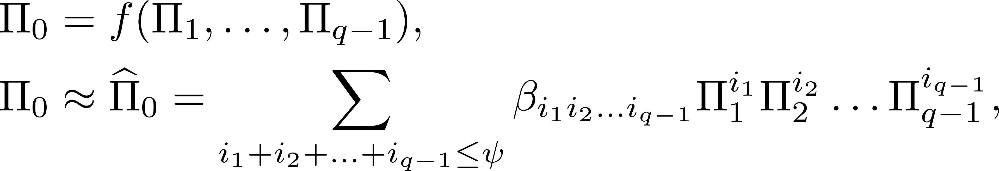
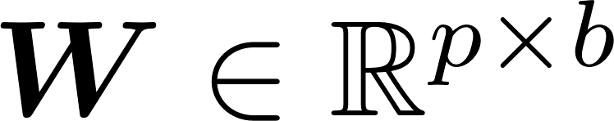
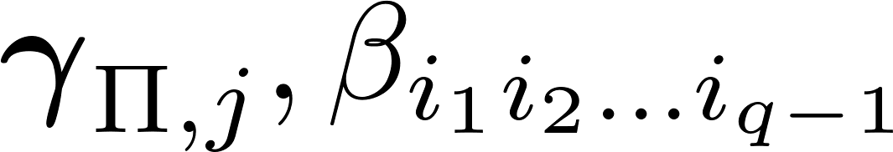
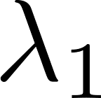
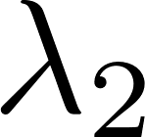
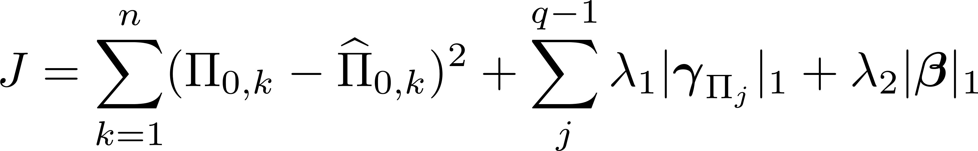
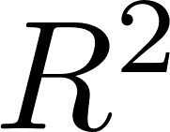
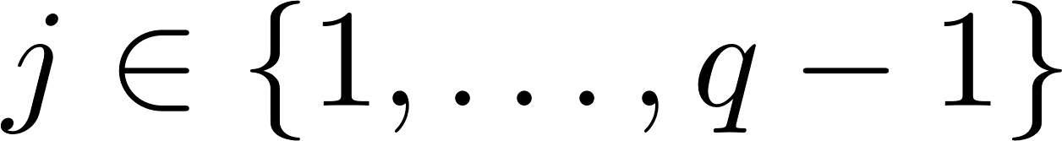

Set Up Dimensionless Numbers
Choose Space of Dimensionless Relationships
d. Choose maximum number of q-1 < b
Construct dimensions matrix :
d-# of dimensions; p-number of variables
e. Choose form of scaling relationship $f:$
c. Calculate basis vectors :
d. Choose maximum number of q-1 < b
are unknown
Discovery of Dimensionless Number
Construct Loss Function
g. Fit:
f. Choose penalties , :
h. Evaluate on unseen data:
choose best f,

Slide 15
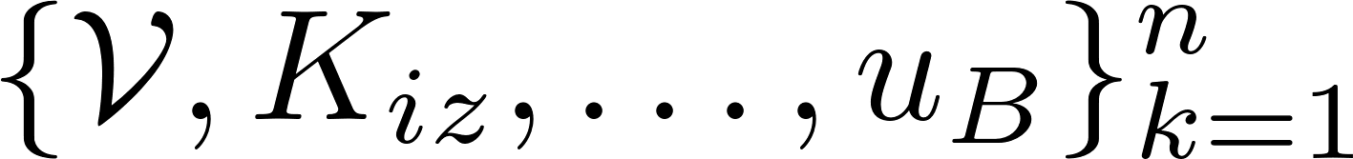
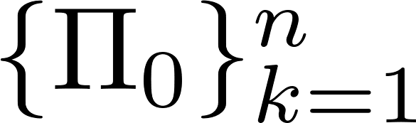
b. Build plasma circuit model:
Mass balance
Energy balance
Charge balance
Set Up Dimensionless Numbers
Choose Space of Dimensionless Relationships
a. Receive processed data and from Figure 1:
d. Choose maximum number of q-1 < b
b. Construct dimensions matrix :
d-# of dimensions; p-number of variables
e. Choose form of scaling relationship $f:$
c. Calculate basis vectors :
b = p - k
are unknown
Discovery of Dimensionless Number
Construct Loss Function
g. Fit:
f. Choose penalties , :
h. Evaluate on unseen data:
choose best f,

Slide 16
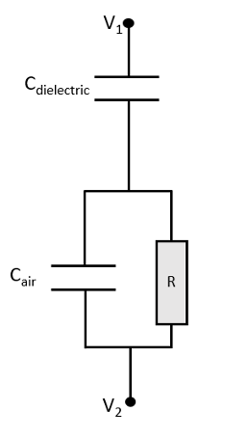
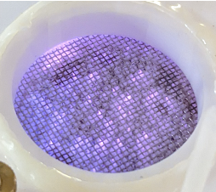

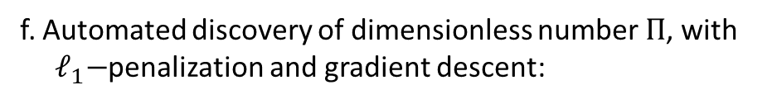

b. Build plasma circuit model:
Mass balance
Energy balance
Charge balance
Data Collection from a ns-PDBD
Global Model of ns-PDBD
a. Collect experimental data:
Operating conditions
Electrical characteristics
Optical emission spectra
b. Build plasma circuit model:
Mass balance
Energy balance
Charge balance
c. Extract physical variables:
Species densities
Pulsing times
Reaction rates
Energies
etc.
Discovery of Dimensionless Number
Construction of Dimension Matrix D from Physics
f. Automated discovery of dimensionless number $Π$, with ${ ℓ}_{1}−$penalization and gradient descent:
d. Build dimension matrix $D$:
e. Calculate basis vectors $W$:

Slide 17

Experimental
Setup
&
Preprocessing
Collected data
Prior
Knowledge
Test parameter
D-Matrix
(show D-Matrix)
DW = 0
Basis vectors of nullspace
Fitting
Dimensionless numbers

Slide 18

Select based on prior knowledge
Experimental
Setup
&
Preprocessing
D-Matrix
(show D-Matrix)
DW = 0
Fitting
Collected data
Test parameter
Basis vectors
of nullspace
Dimensionless numbers
Prior
Knowledge

Slide 19
Experimental
Setup
&
Preprocessing
Collected
data
Prior
Knowledge
Select based on prior knowledge
Test parameter
D-Matrix
(show D-Matrix)
DW = 0
Basis vectors
of nullspace
Fitting
Dimensionless numbers

Slide 20
Experimental
Setup
Preprocessing (smoothing, averaging, etc)
Processed data
Prior Knowledge (previous experiments, incomplete governing equations, etc)
Collected data
Test parameter
Fitting
D-Matrix
(show D-Matrix
Basis vectors of nullspace
Dimensionless numbers

Slide 21
Experimental
Setup
&
Preprocessing
Collected data
Prior
Knowledge
Test parameter
D-Matrix
(show D-Matrix
Basis vectors of nullspace
Fitting
Dimensionless numbers

Slide 22
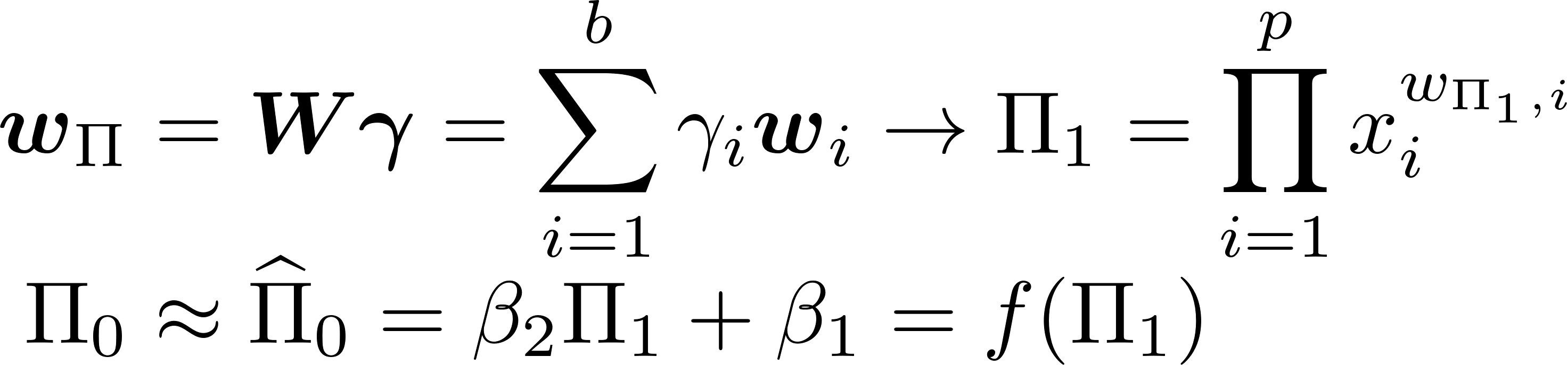

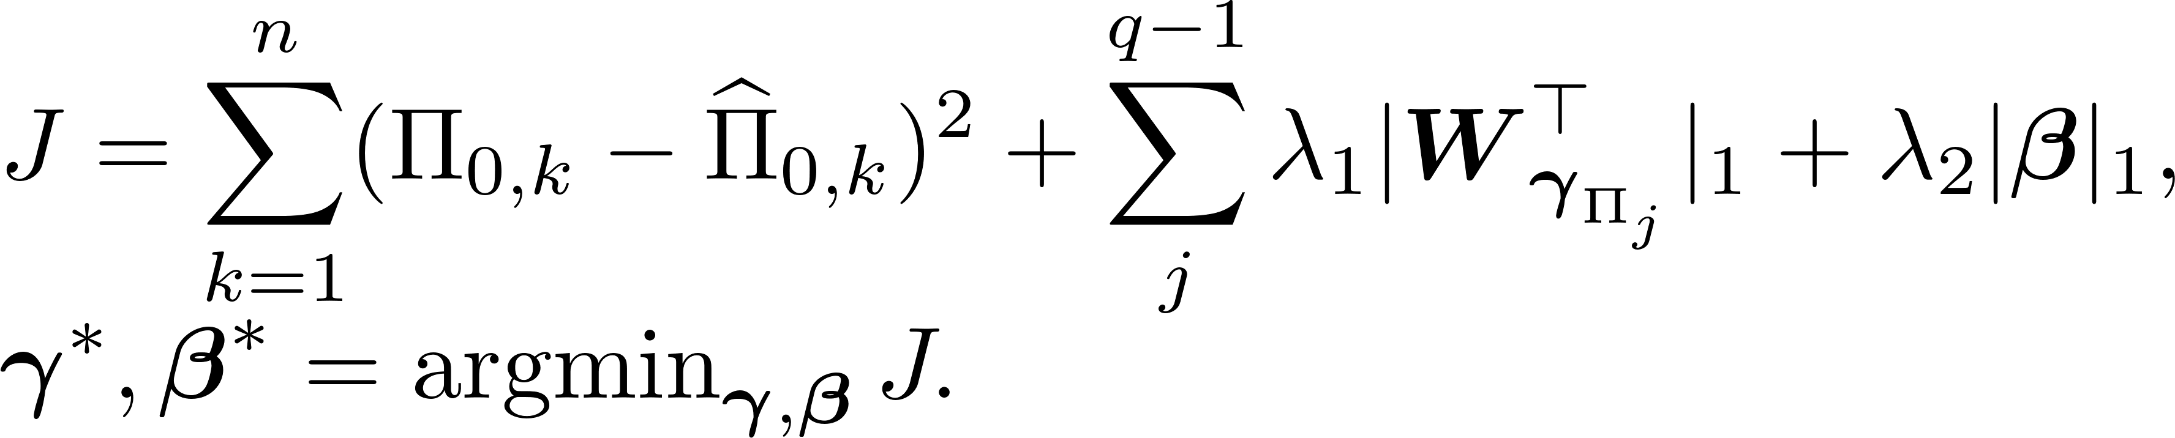
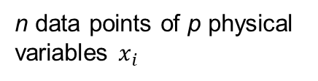
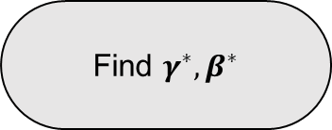
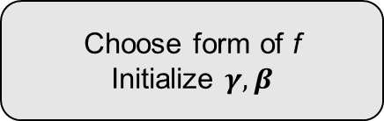
Data Collection & Preprocessing
Processed Data
Prior Knowledge Parameter Space Reduction
n data points of p physical variables $x_{i}$
Dimension Matrix Construction
Basis Vectors
Choose form of f
Initialize $γ, β$
Find $γ^{∗}, β^{∗}$

Slide 23
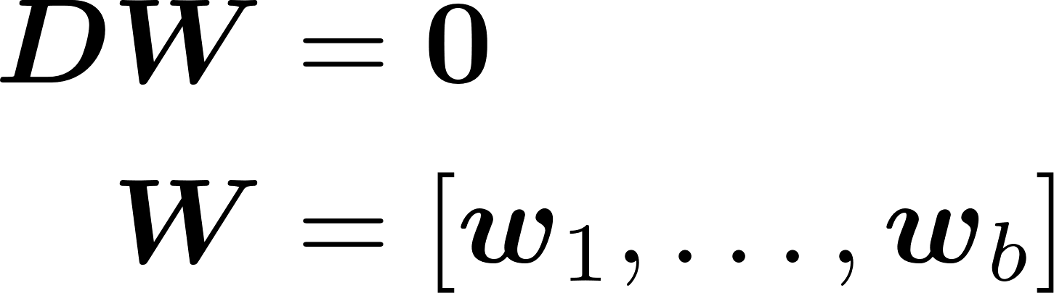
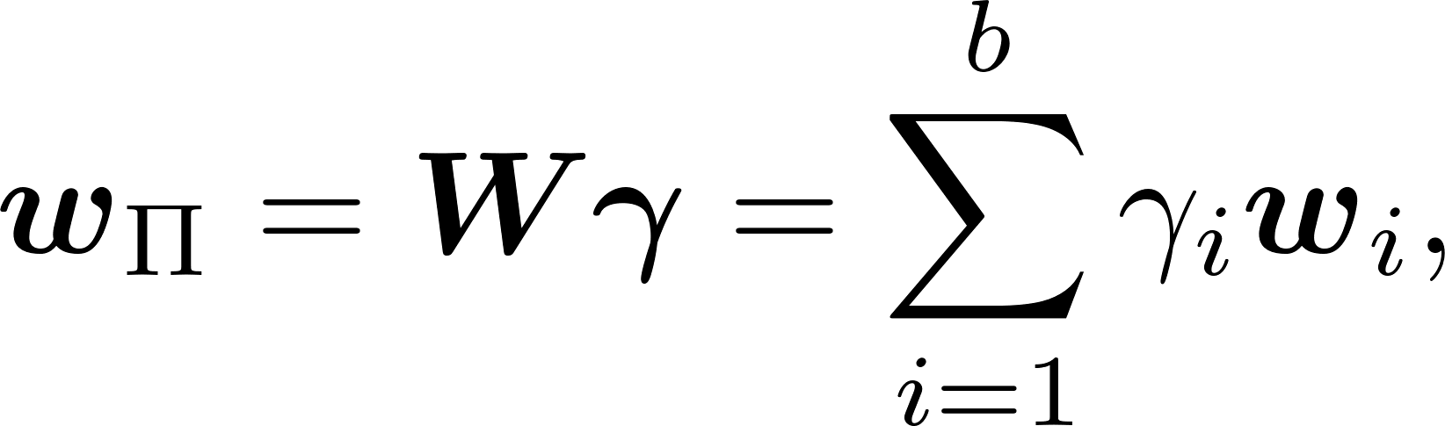
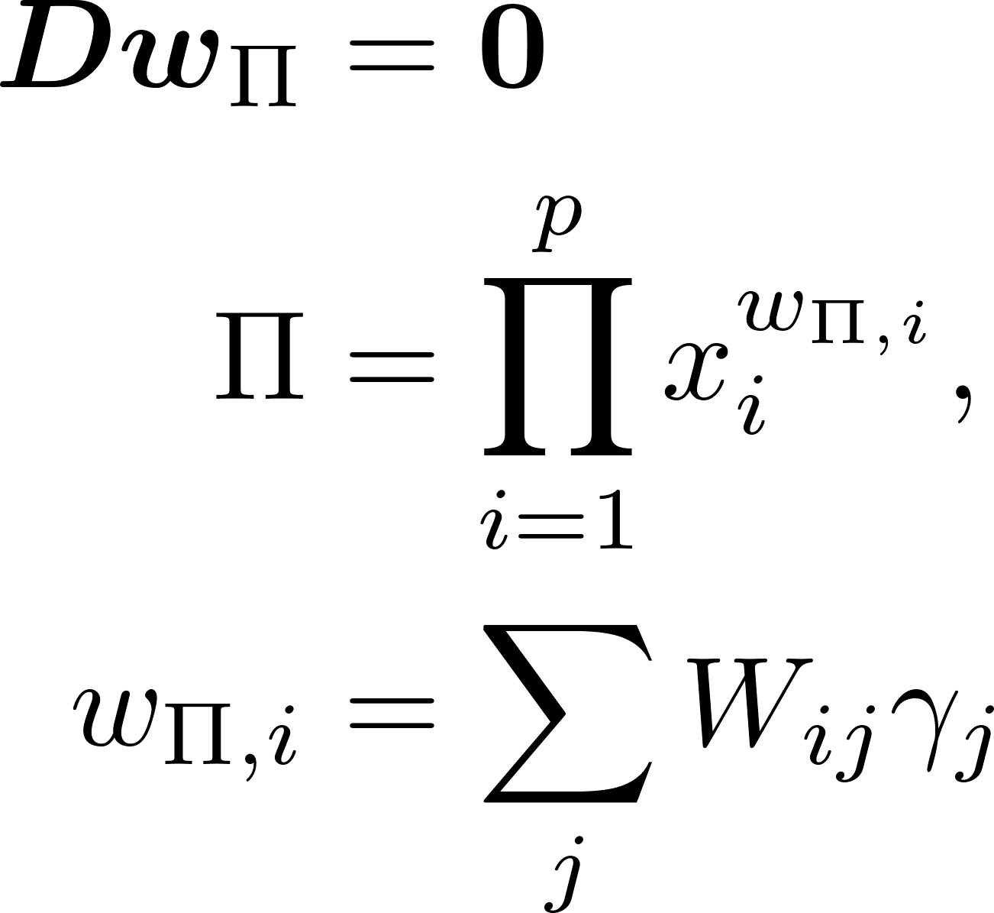

Slide 24


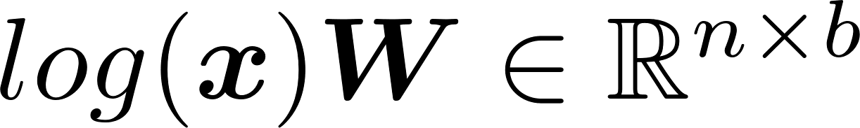
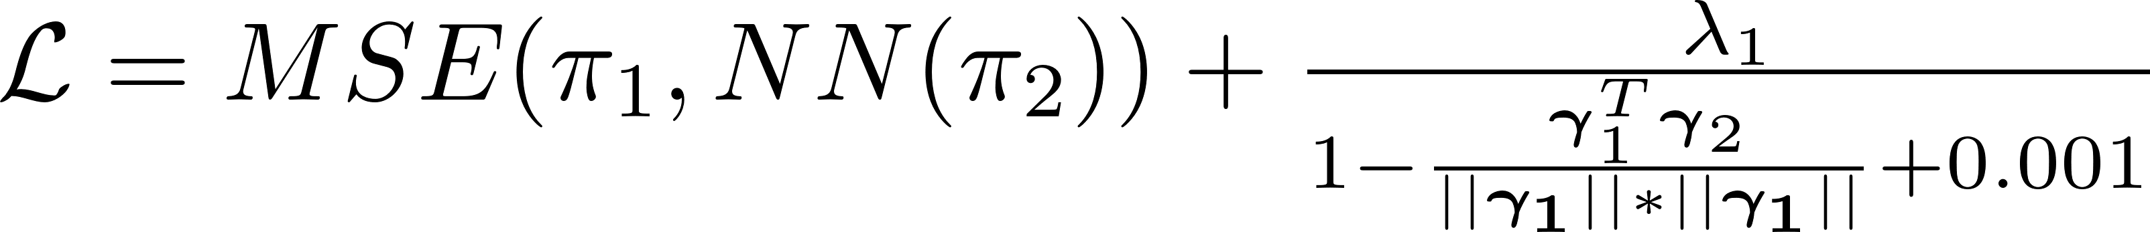

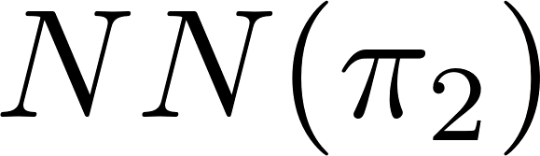
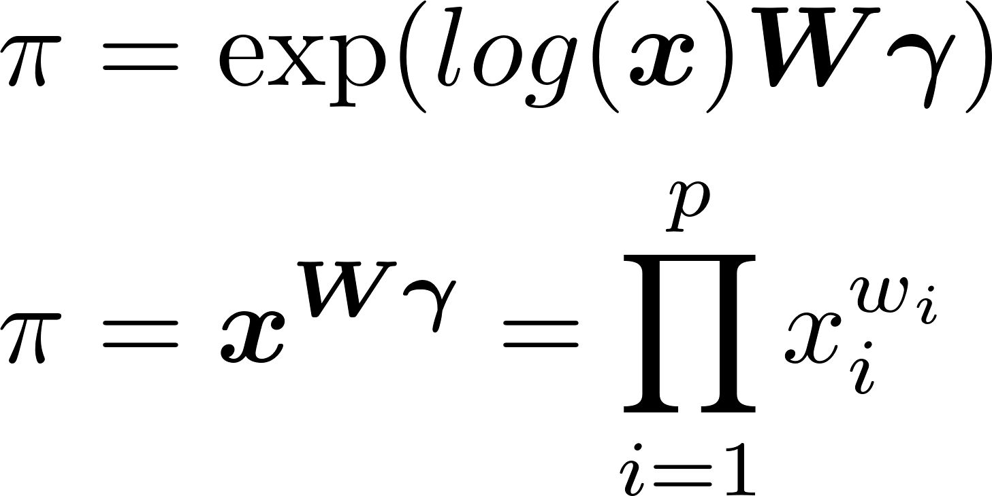





$$x$$
b inputs
Layer 1:
No biases!
q = 2
$π$ numbers
Avg loss: 0.36
Avg acc: 0.36
Hyperparameters:
q -- # of $π$
W –hidden layers
$λ_{1}$ --0
MSE vs MSRE
Epochs: 600
L2 Penalty: 1e-4
Learning Rate: 1e-4

